Slide 1
Predicting Reaction Mechanisms using Transfer Learning with Variational Auto Encoder
Leon Zhang & Chowdhury Ashraf

Slide 2
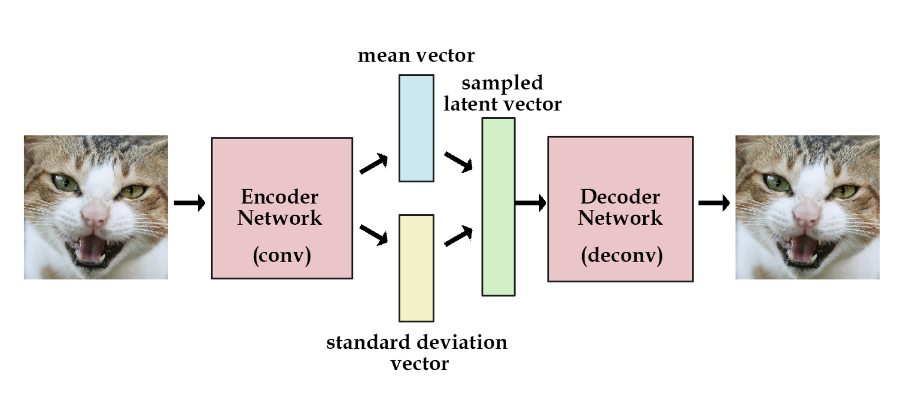
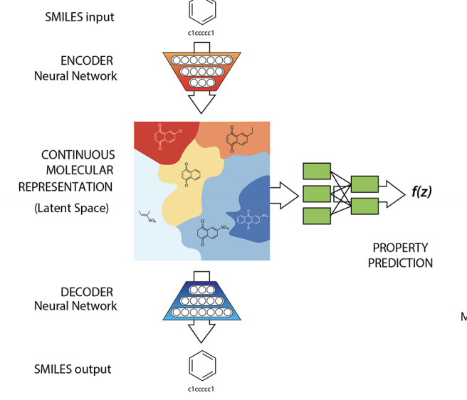
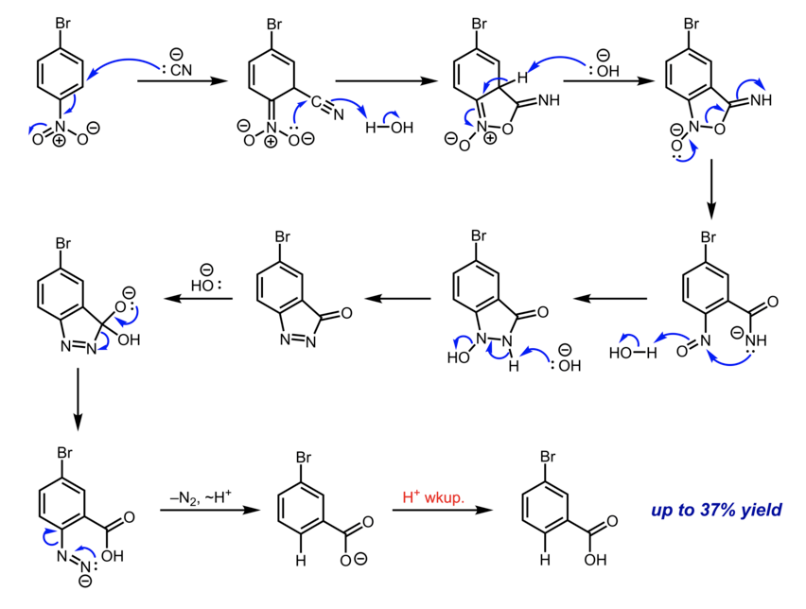
General Concept
2. Generate a database of reactions with energetics(smile strings of multiple molecules separated by period)
Train a VAE on an existing database of molecules (QM9 dataset)
Jointed Smiles | U | H | F
mol1.mol2.mole3 | ... | ... | ...
mol4.mole5 | ... | ... | ...
mol6.mol7.mol8.mol9 | ... | ... | ...
3. Use transfer learning to train another VAE with the reaction database integrated with QSPR
4. Predict reaction mechanisms and validate them with DFT.

Slide 3
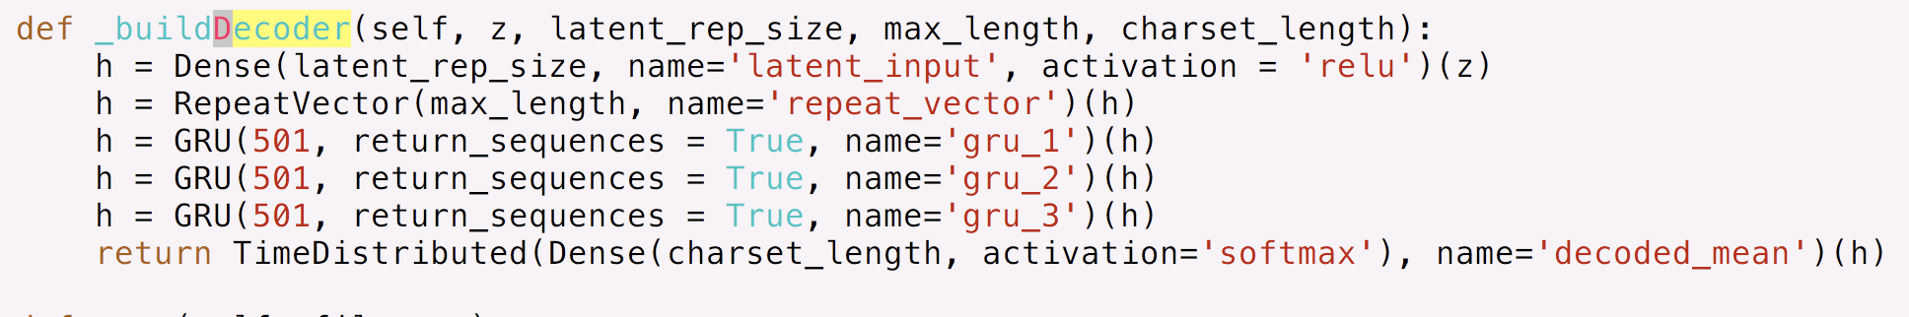
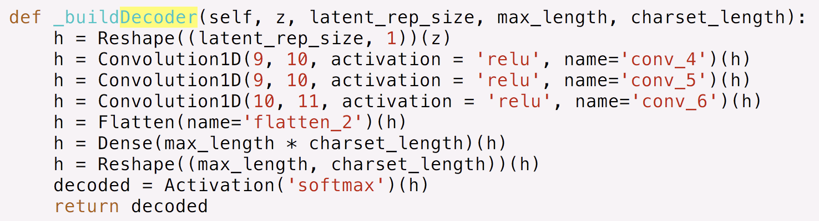
Train a VAE on an existing database of molecules
QM-9 database:
Small molecule dataset, contains energies, 134K small molecule dataset made up of CHONF.
Removed molecules that contain N and F, number of molecules left ~ 108K
Training Protocol:
We took the VAE model used by Wes and trained our dataset in Google Colab using GPUs
Each epoch took ~4 mins
Training accuracy was stuck at ~93%
Darkchem Architecture: developed at PNNL
Wes’s Architecture
Training time/epoch = ~22 s
>98% training and > 97% validation accuracy after 100 epochs
DarkChem Architecture

Slide 4

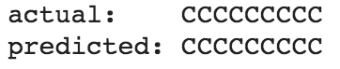
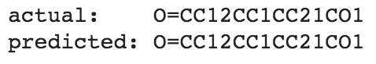
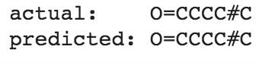
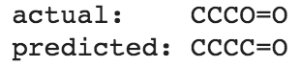

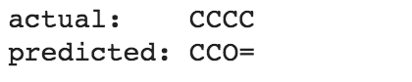
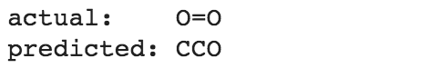
Some Predictions from our VAE Model
The model can predict the large molecules accurately, but there are some issues predicting the smaller ones.
1/6 off
Bootstrapping from a subset of smaller molecules so that the model can see them more frequently
Transfer learning
2/4 off
2/3 off

Slide 5
Current Model: Can only learn single small molecules
Encoder
Decoder
Single Small Molecules:
Only include C,H,O
Eg. CCC, CCCO, C=CC
Latent Space
Input layer: Single molecule SMILE string
Output layer: (Ideally the same single molecule)
Goal Model: Can learn reaction sets + QSPR prediction
Reaction Molecules Set:
C,H,O
C < 4, O < 2, H < 10
Eg. CCC.O=O.O=O.O=O.O=O.O=O -> C(=O)=O.C(=O)=O.C(=O)=O.O.O.O.O
(propane + 5 O2 -> 3 CO2 + 4 H2O)
Encoder
Latent Space
Decoder
Training Data: Need to find these reaction sets for each small molecules
Input layer: Reaction molecules set SMILE string
Output layer: Reaction Molecules SMILE string
QSPR output layer
Notes:
Current model can only reconstruct single small molecules
But our goal is to create a model that could take in reaction sets + additional property predictions. QSPR (quantitative structure property relation eg.charge density, hydrophobic surface area) prediction will be done by adding another output layer onto the latent space, since the latent space has the most condensed feature representation of our molecules.
So to create this model, we first need a good training dataset which contains all the combinations for every small molecules

Slide 6
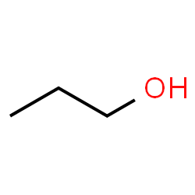
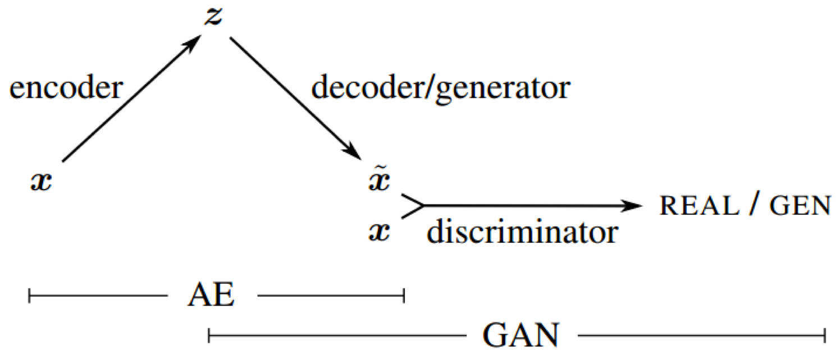
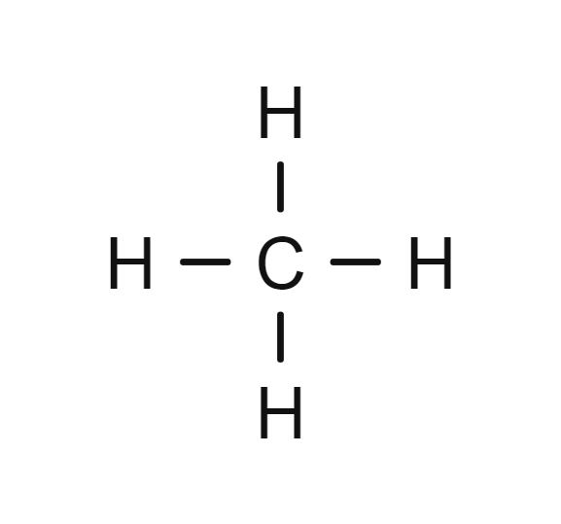
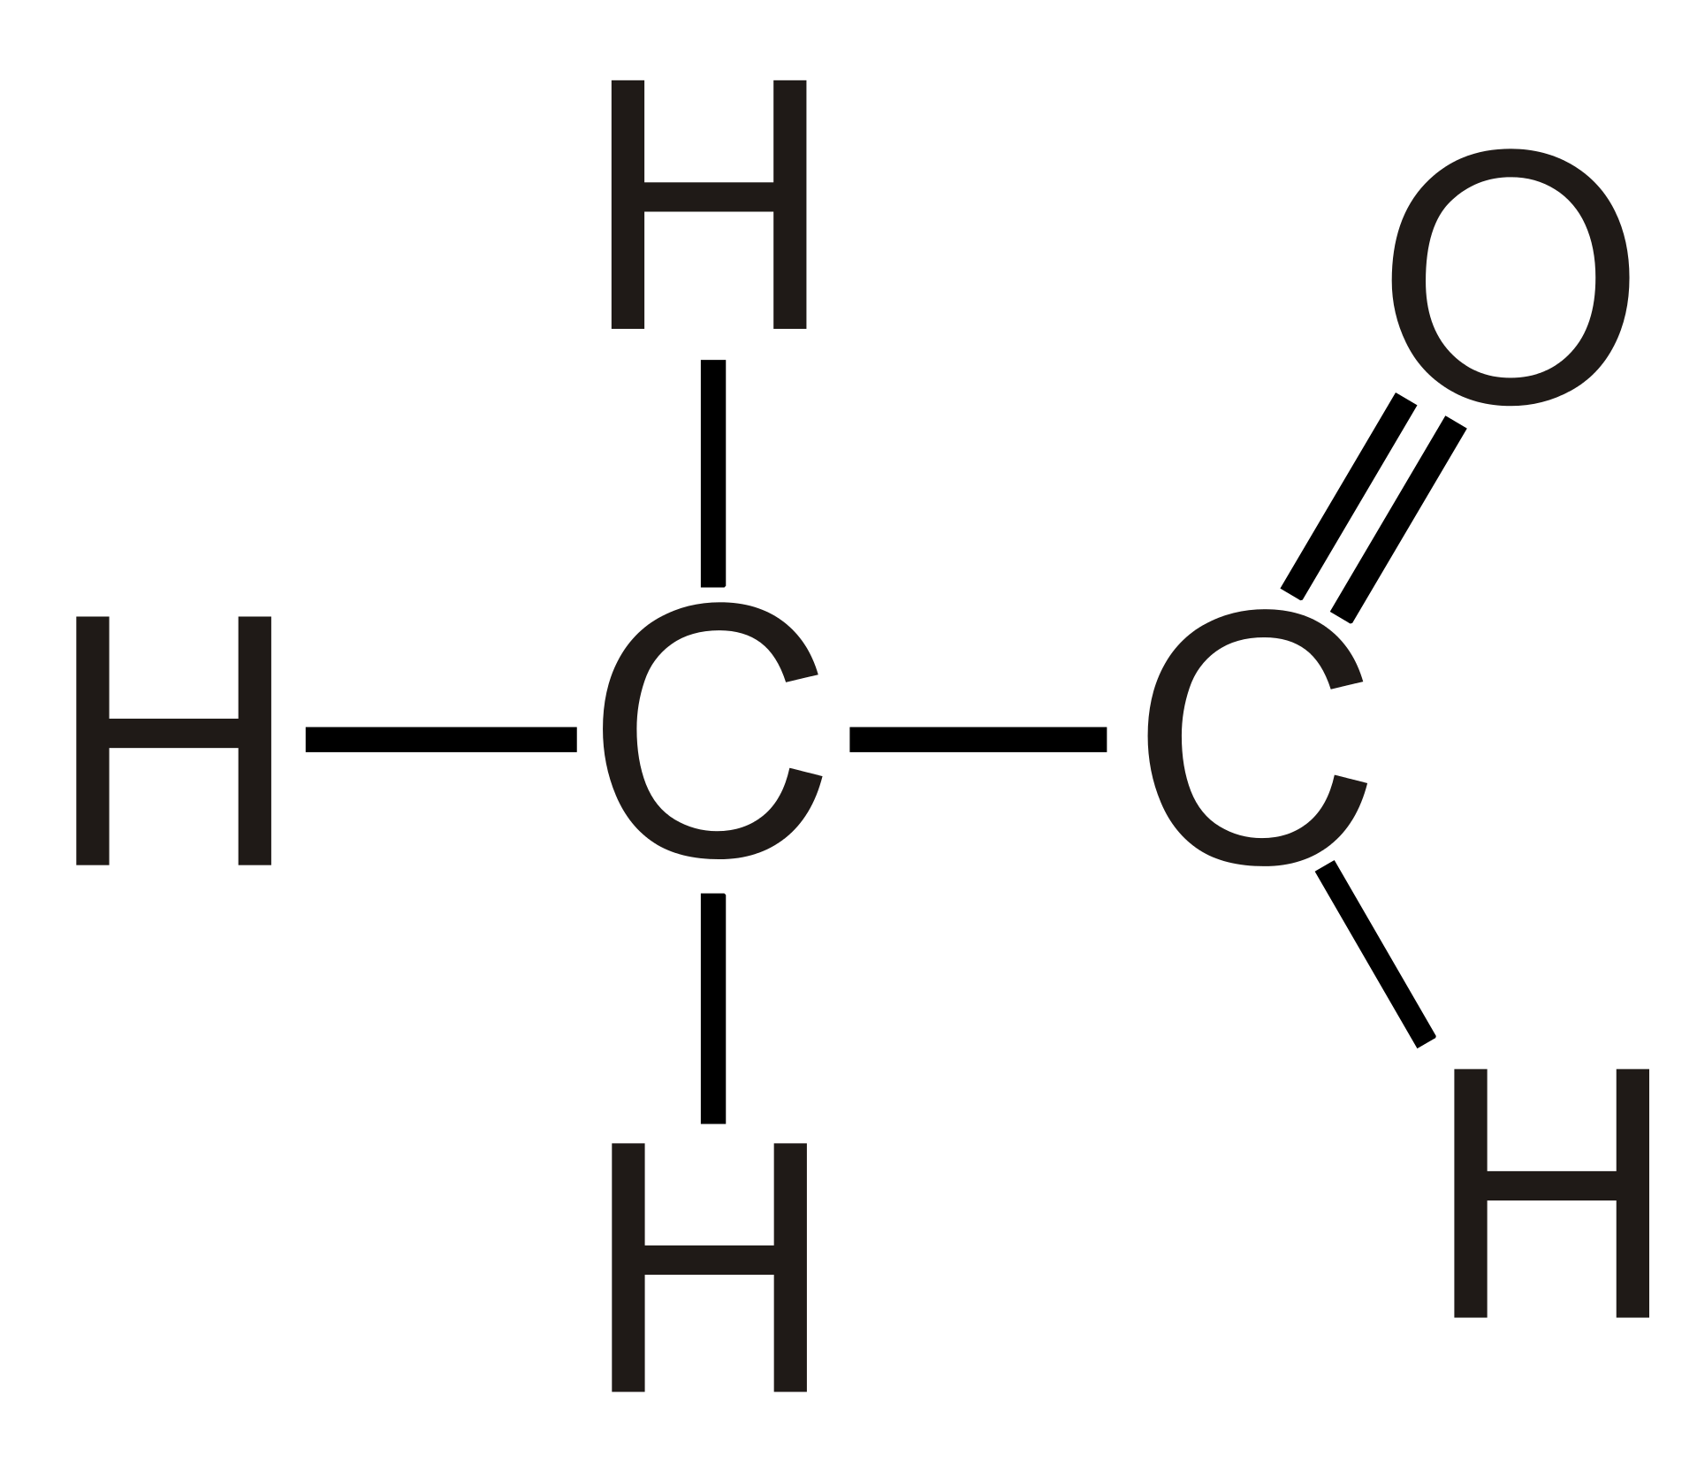
Finding Combinations
What do we mean by a combination: Any set of molecules that conserves the mass of its parent molecule
For example, we have propanol:
A possible combination of propanol
Future considerations: VAE-GAN to exclude impossible reaction sets
Notes:
We define a combination or a reaction set as any set of molecules that conserves the mass of its parent molecules. For now we will include combinations that are impossible to form in real life. Later on, we will try to exclude them with QSPR prediction.
Propanol = methane + ethanal

Slide 7
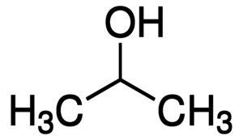
Combinations could also be:
Combination could be:
Size 1
Size 2
Size 3
.
.
.
Size N
Combination 1
Combination 2
...
And so on
...
Multiple small molecules
Isomer
Notes:
Some more examples
A combination could be a isomer of its parent molecule which is size 1
Therefore we need a very efficient way of finding them

Slide 8
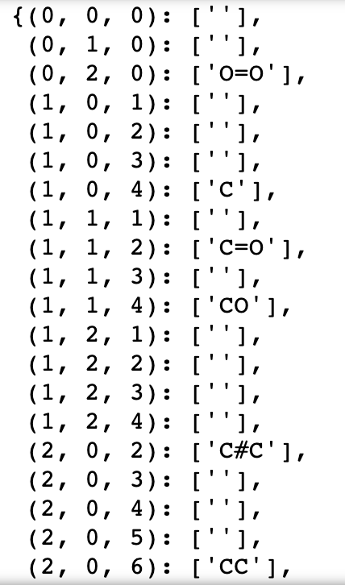
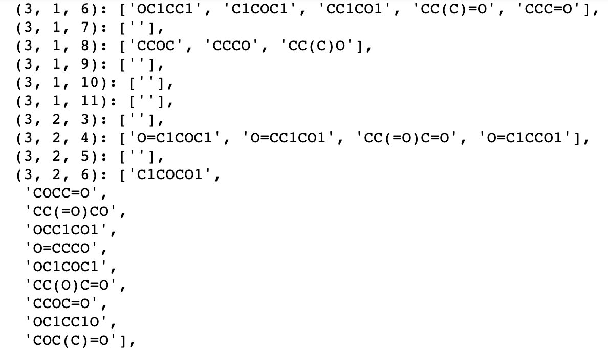
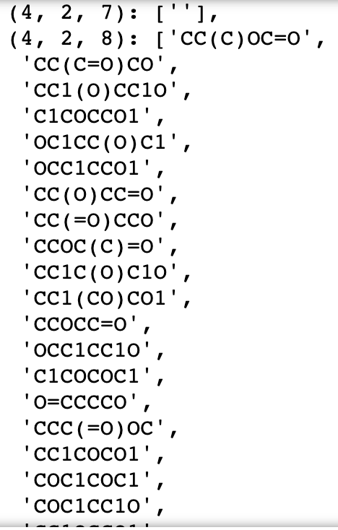
Preparing for the Reaction set database
Notes:
To find these combinations Luke helped us made for this database that contains all the molecules we making combinations from. All molecules have a tuple representation of their molecule count. The first index refers to the Carbon count, the second index is the Oxygen count, the last is the Hydrogen count. This was convenient for checking the whether the atoms conserved in making combination

Slide 9
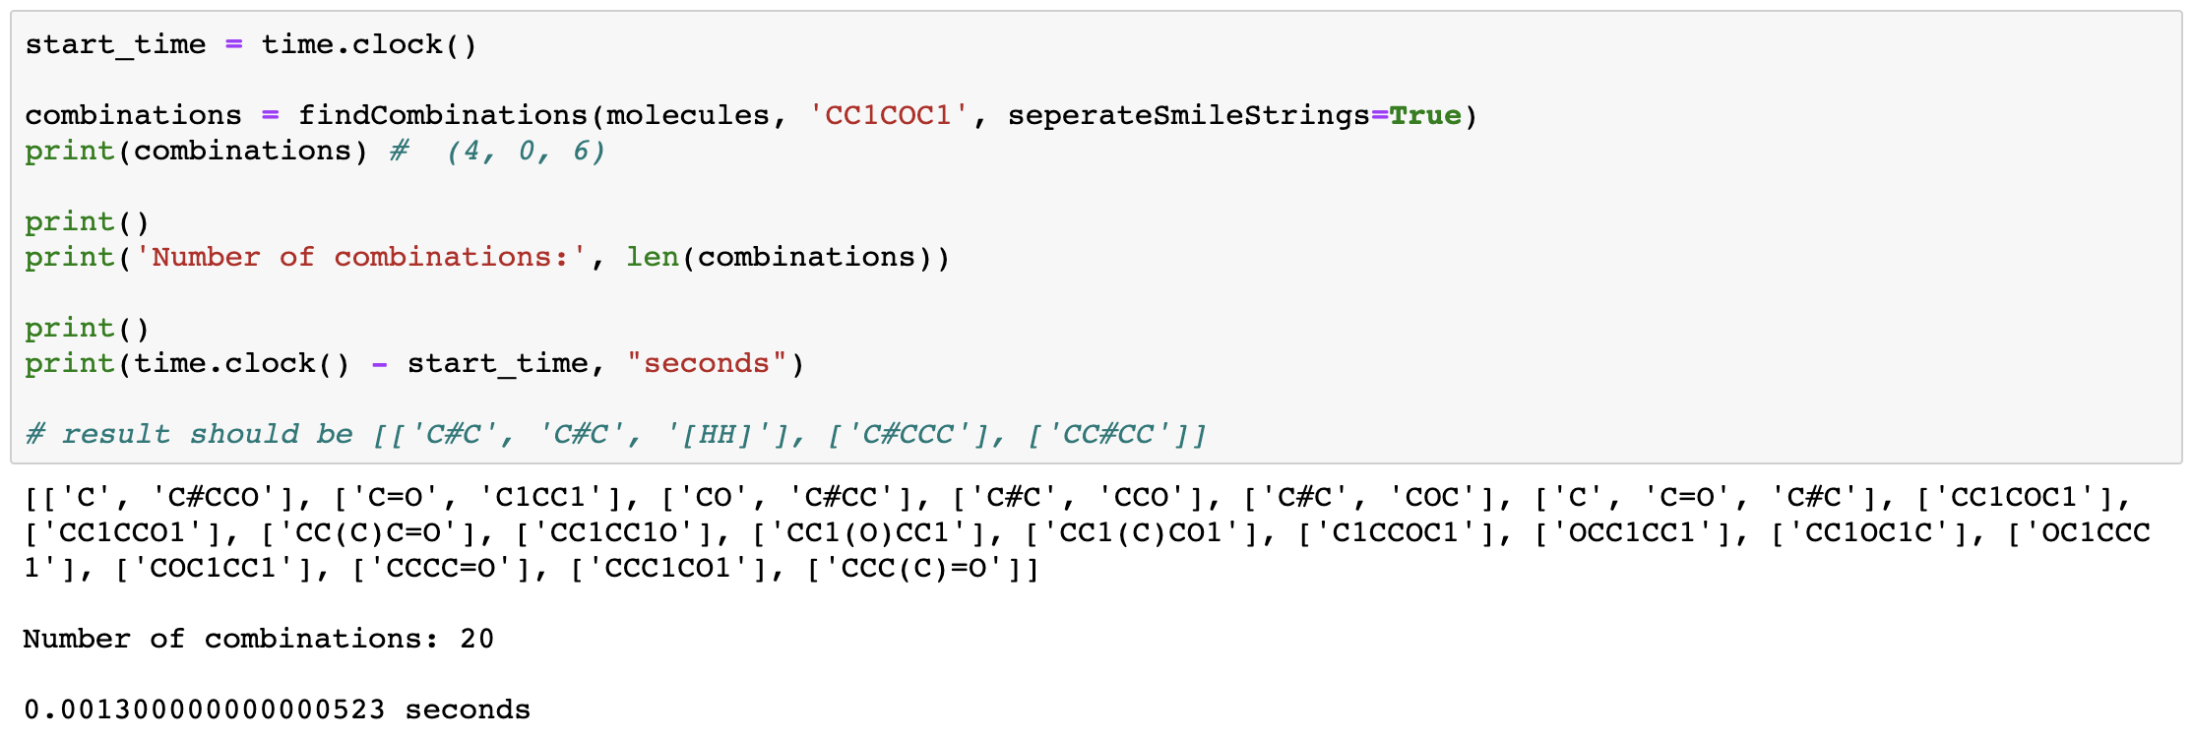
Algorithms for Finding Combinations
The brute force algo that finds all combinations
The cheating algo which cannot guarantee to find all combinations
Example call
Notes:
We developed 2 algorithms for finding combinations that will go into details:
The brute force algo and the second one is the cheating algo which does guarantee perfect solution
Example function call: input a molecule dataset and the SMILE string of the molecule we want to find combination with.

Slide 10
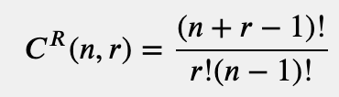
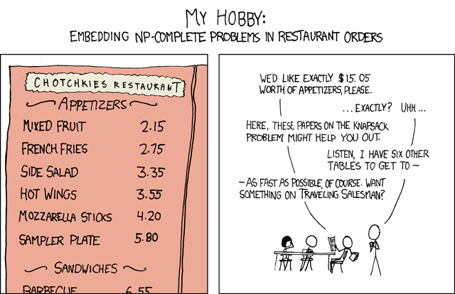
Brute Force Algo
Finds all size 1 combinations (isomer) of parent molecule
Finds all size 2 combinations of parent molecule
Finds all size 3 combinations of parent molecule
...
Finds all size N (total number of atoms in parent molecule) combinations of parent molecule
NP Issue: Runs in O(N^N)
NC1 with replacement
NC2 with replacement
NC3 with replacement
NCN with replacement

Slide 11
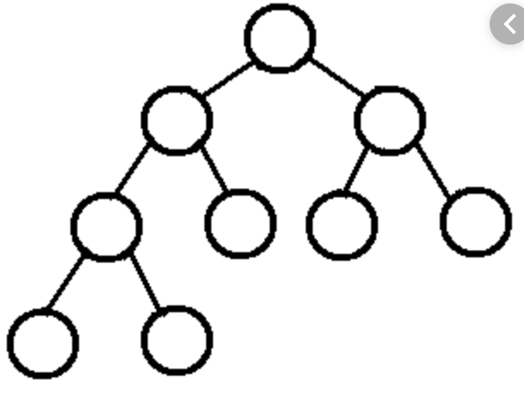
Cheating Algo
Find all size 2 combinations of parent molecule
For each child from previous generated combinations:
Find all size 2 combinations of child
For each child (now the parent):
Find all size 2 combinations of child’s child
For each ...:
…
Issue: What if the molecule doesn’t have size 2 combination but have size 3?
Recurse until there’s no more to break down
Notes:
The issue with this algorithm is that if a molecule cannot be break into size 2 combination it’s successor path will be blocked

Slide 12
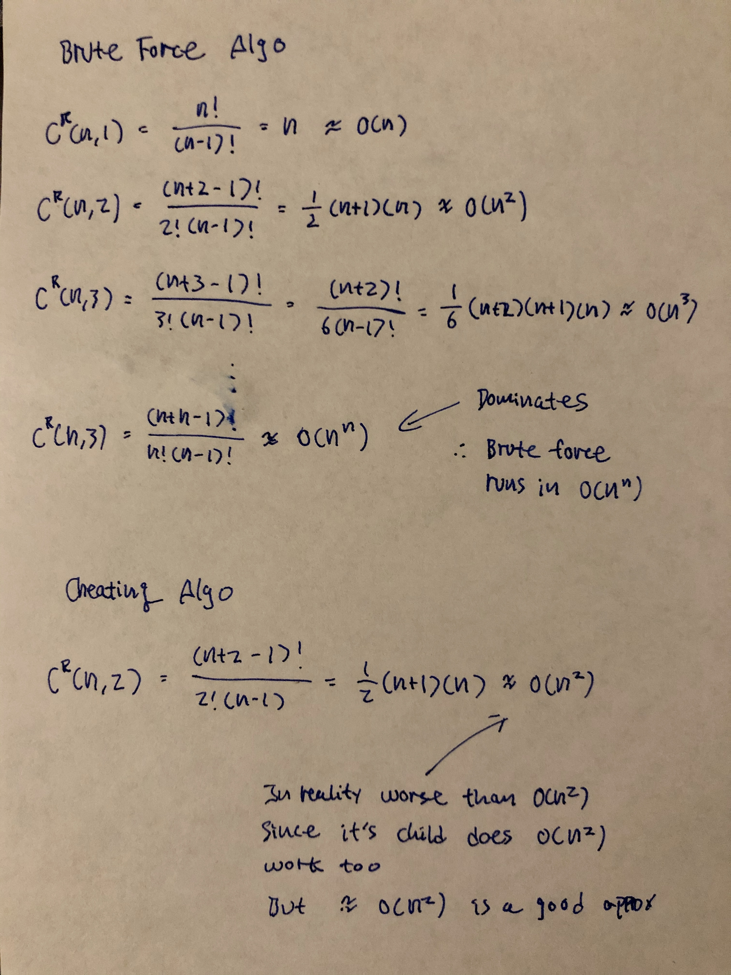
Time Complexity Analysis

Slide 13
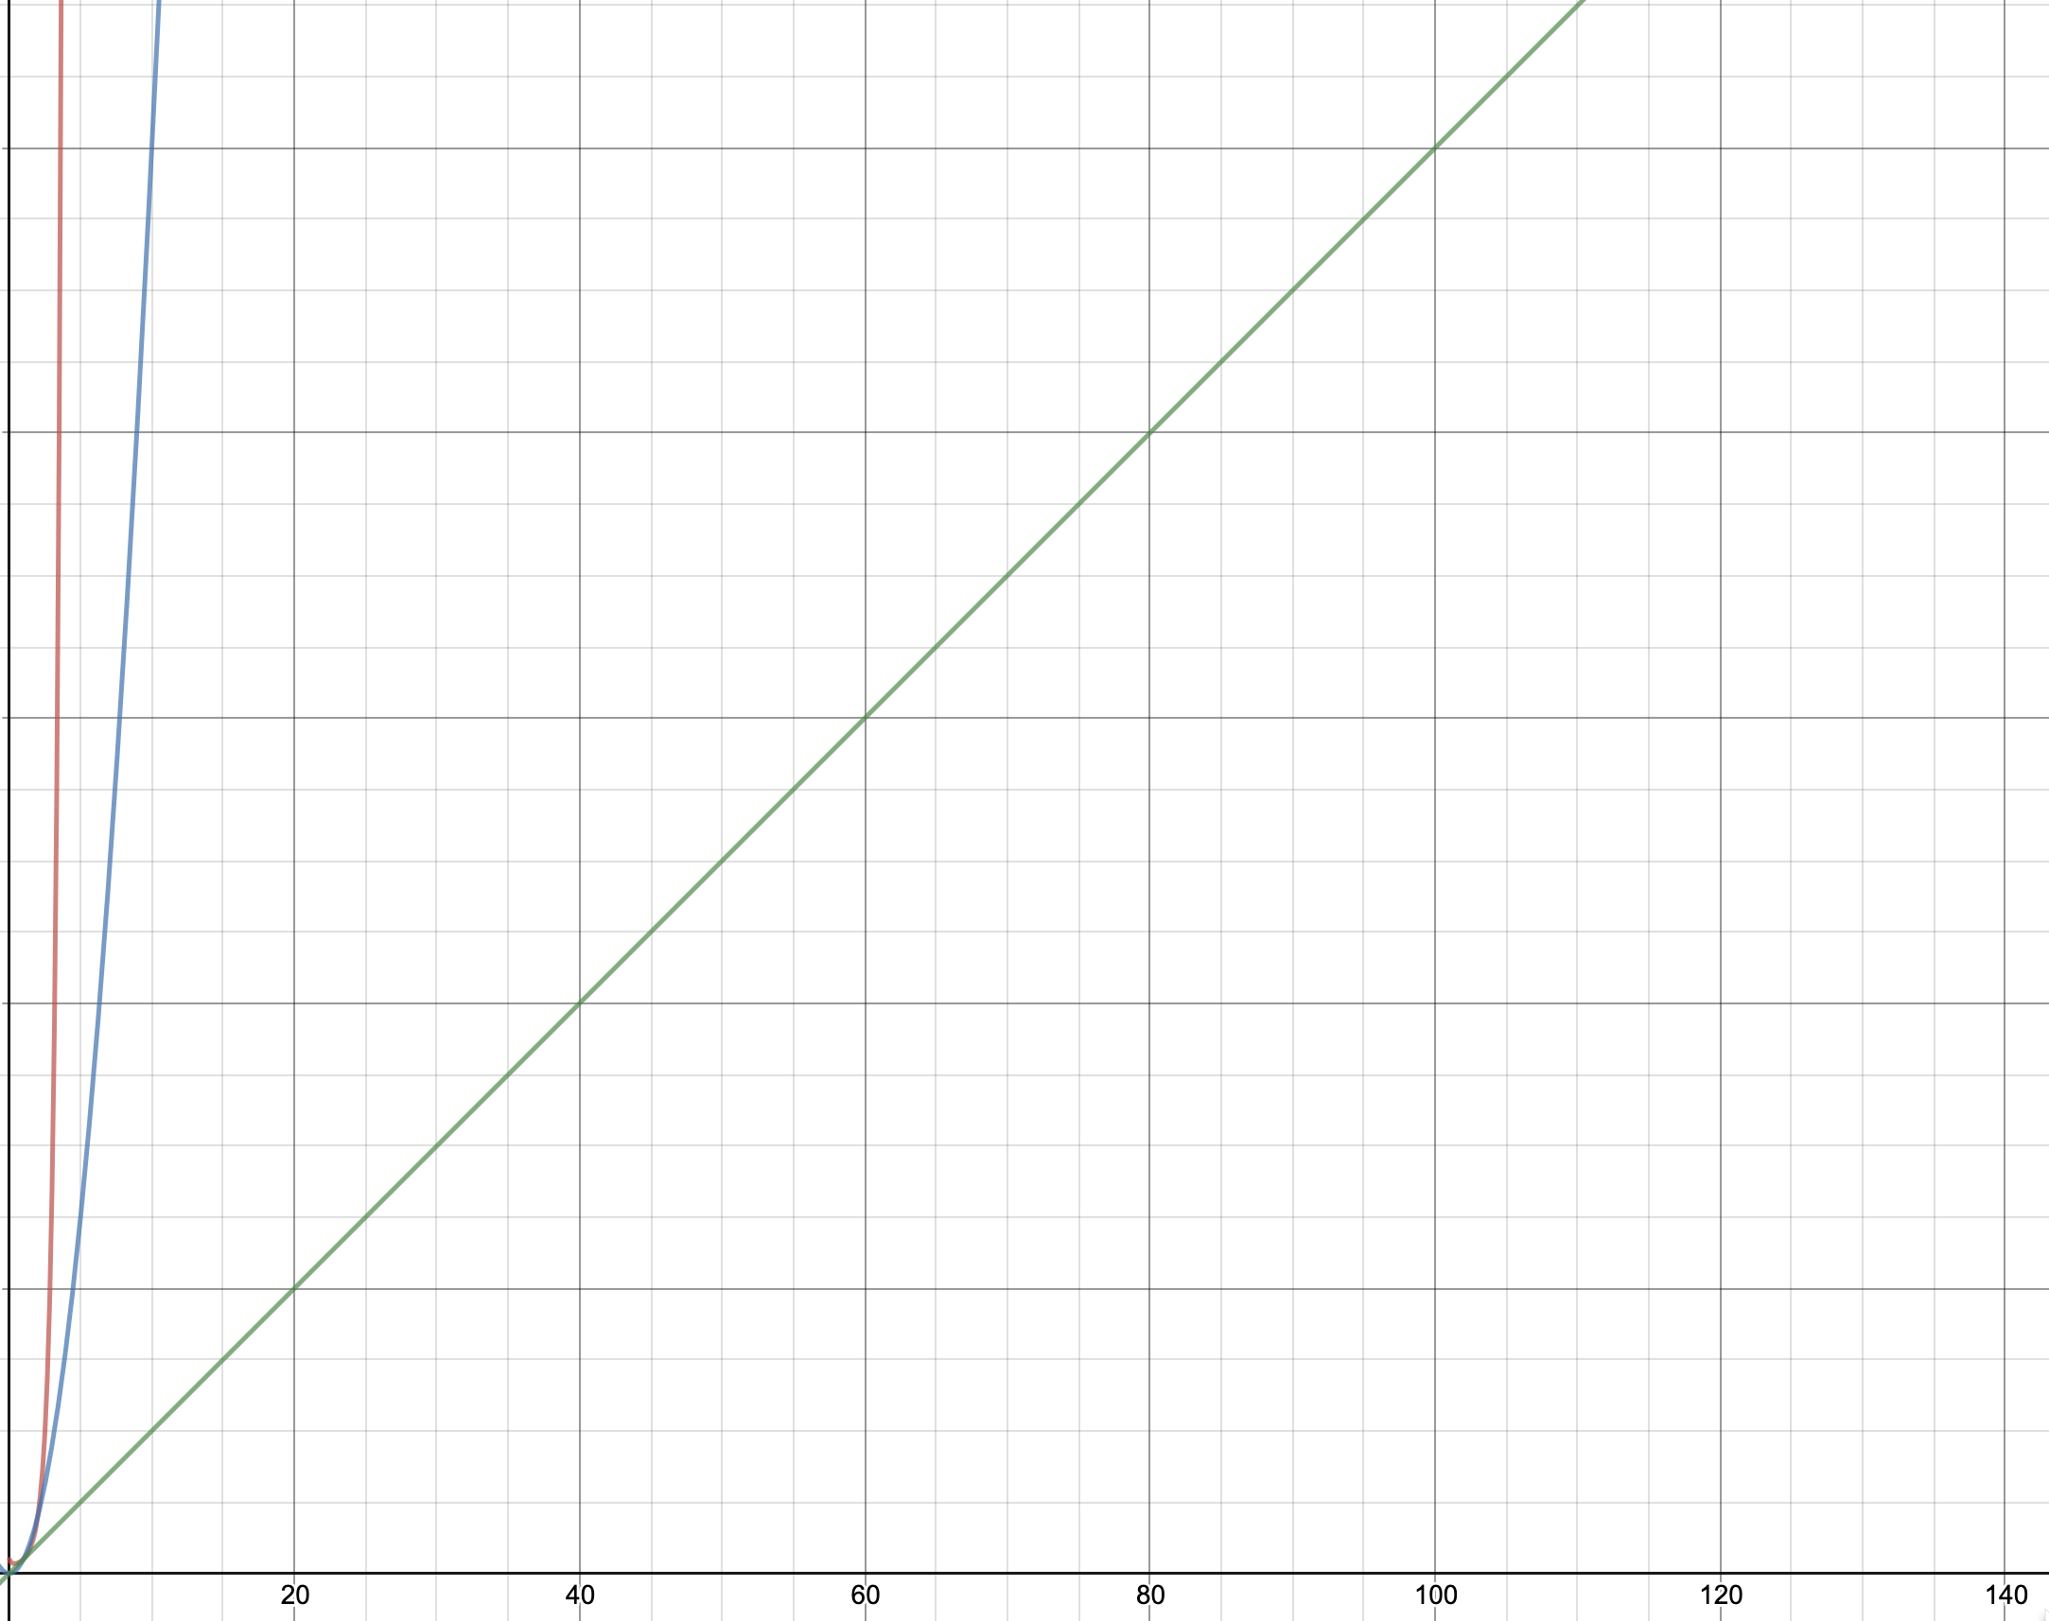
Time complexity Plot
O(N^2): Cheating Algo
O(N^N): Brute Force Algo
O(N): Linear complexity

Slide 14
Decision
Cheating algo: As the parent molecule size increase, cheating algo is less likely to cheat, and it’s super fast (we could even expand our data by including larger molecules).
Brute force algo: Takes forever for molecules > size 12, but relatively fast for small molecules.
Therefore, use both algos to create the database:
First find all combinations with cheating algo
For the ones that cheating algo missed, use the brute force algo
Notes:
Because there is more pathways to get to the same combinations.

Slide 15
Next Step
Transfer learning: Train new model to reconstruct reaction sets
Training data for QSPR: Add delta U, H, F to reaction sets
QSPR Prediction: Add an additional dense layer onto the latent space
Exclude Impossible Reaction Sets: Add GAN Network to discriminate against impossible reaction pathways
VAE-GAN

Slide 16

Questions

